Slide 1


Ticket Booking System 2
The Return

Slide 2
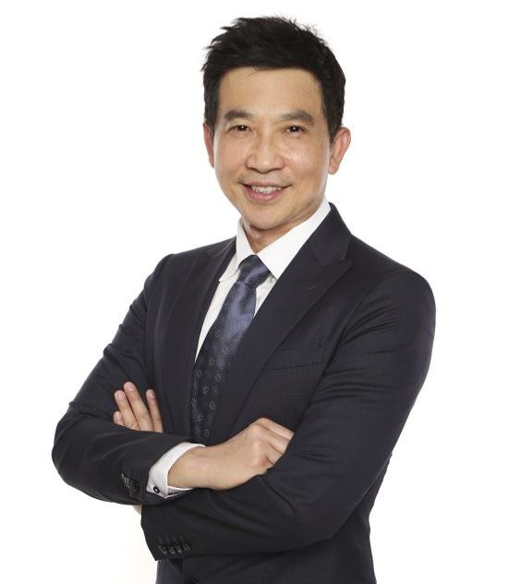
Remember your Ticketing project from the PHP Module?
A new requirement has arrived from Head Office!
The client was happy with the Ticketing Website you made for them.
But, now they want to use it to manage tickets for the 2023 SEA Games! It must now also support many mobile apps, and a Windows app, and a bot to automate event management.
How can we do this?
I am a businessman with important business requirements!

Slide 3
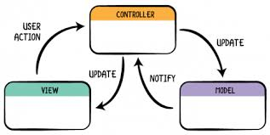
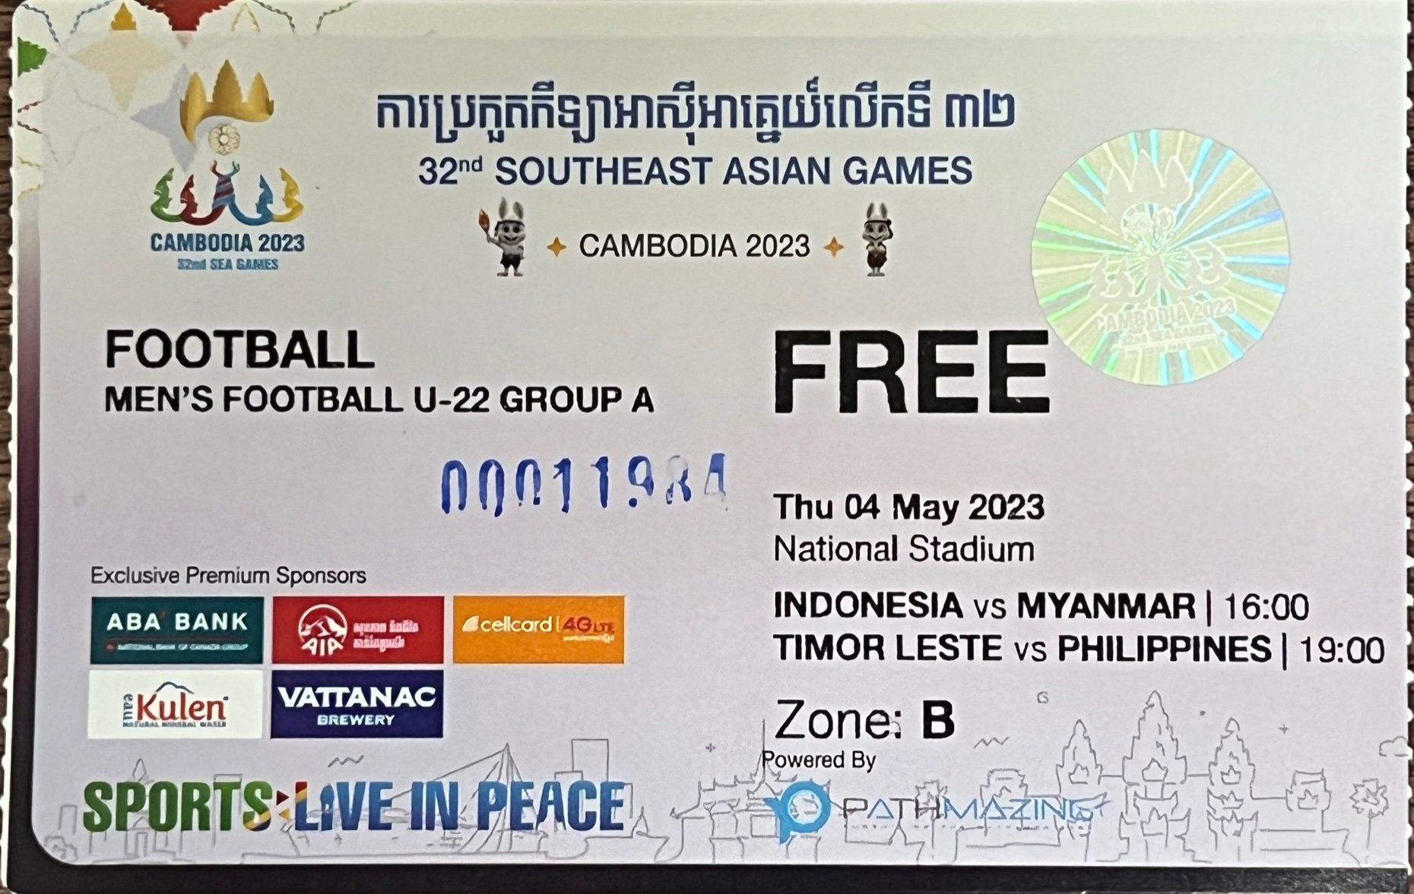
Remember your Ticketing project from the PHP Module?
Did you use the MVC design pattern?
If so, you will find this project much easier!
Laravel project:
Create a REST API to book tickets.
You can reuse your earlier code!

Slide 4
Code Reuse
Create a new Laravel project
Import (copy) your model layer and the database from your PHP Project code
You can also use parts of the controller layer if you find them useful
Write new controller functions, to support a REST API that performs the required actions
Write and save tests in Thunder Client or Postman to show your code working!

Slide 5
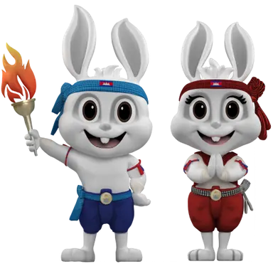
Requirements List
Create and test API endpoints that perform each of these actions:
List all events (basketball, volleyball, etc…)
Search for an event
Get event details (teams, time, description, etc…)
Buy a ticket
Create an event
Delete an event
Edit an event

Slide 6
Other Requirements…
SEA Games tickets are General Admission - no seat numbers are given on the ticket.
Authentication (login, buyer or seller etc) is not required for this project.
The only front-end requirement is a set of Thunder Client (or Postman) tests. No need to make the mobile, Windows, or bot apps!

Slide 7
Deliverables
Your git repository should contain:
Your code
Everything needed to create the database and fill it with test data
A set of Thunder Client or Postman tests
Written documentation for your API, explaining the expected input and output for each endpoint.
You may be asked to demonstrate all tests running on your laptop.

